Slide 1
The use of mixture distributions in a Bayesian linear mixed effects model
Anirudh TOMER
Promoter: Professor Emmanuel LESAFFRE

Slide 2


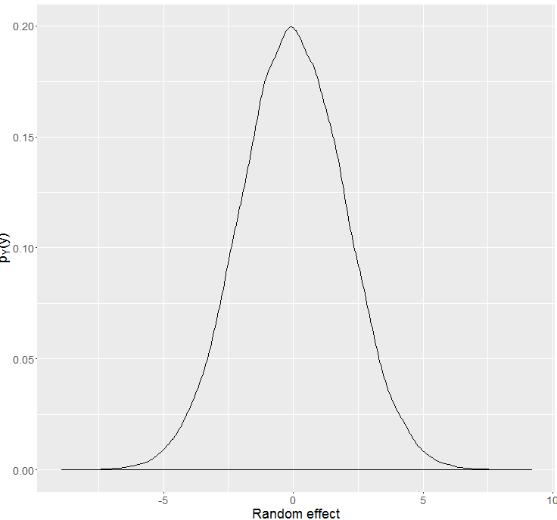
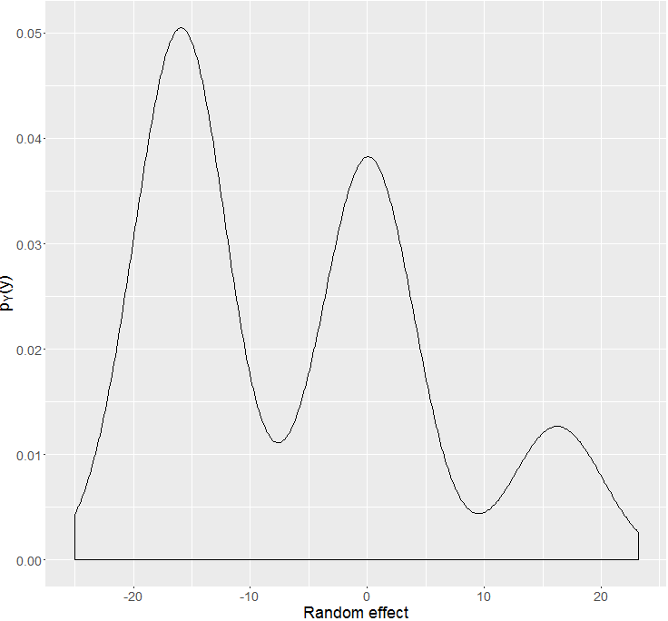





Bayesian heterogeneity model
Gender: Male, Age: 37
Gender: Female, Age: 23
Gender: Male, Age: 41
Gender: Female, Age: 59
Gender: Female, Age: 35
. .
.
. .
.
Gender: Male, Age: 19

Slide 3
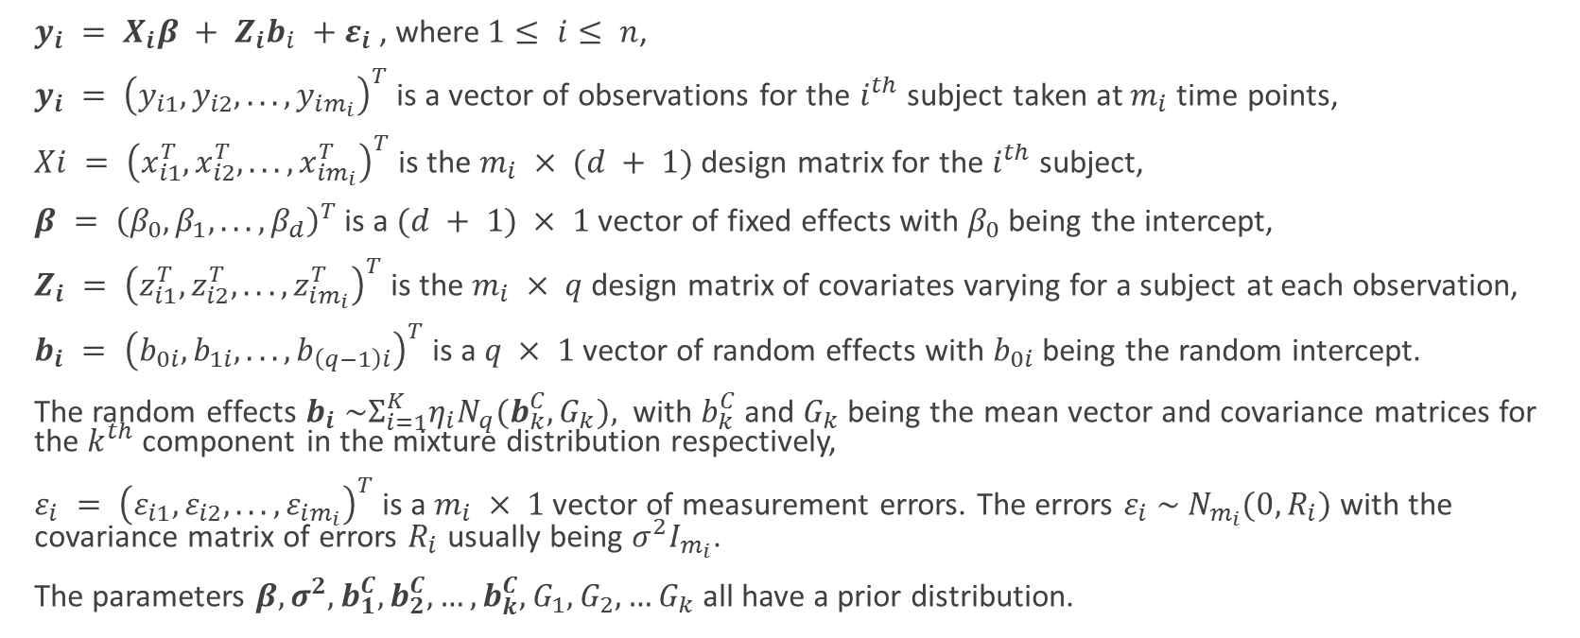
Bayesian μοντέλο ετερογένεια στα ελληνικά (Bayesian heterogeneity model in Greek)
$y_{i} = X_{i}β + Z_{i}b_{i} +ε_{i}$, where$1≤ i≤ n$,
$y_{i} = {\left(y_{i1}, y_{i2}, . . . , y_{im_{i}}\right)}^{T}$is a vector of observations for the $i^{th}$ subject taken at $m_{i}$ time points,
$Xi = {\left(x_{i1}^{T}, x_{i2}^{T}, . . . , x_{im_{i}}^{T}\right)}^{T}$is the $m_{i} × (d + 1)$ design matrix for the $i^{th}$ subject,
$β = {\left(β_{0}, β_{1}, . . . , β_{d}\right)}^{T}$ is a $(d + 1) × 1$ vector of fixed effects with $β_{0}$ being the intercept,
$Z_{i} = {\left(z_{i1}^{T}, z_{i2}^{T}, . . . , z_{im_{i}}^{T}\right)}^{T}$ is the $m_{i} × q$ design matrix of covariates varying for a subject at each observation,
$b_{i} = {\left(b_{0i}, b_{1i}, . . . , b_{\left(q−1\right)i}\right)}^{T}$is a $q × 1$ vector of random effects with $b_{0i}$ being the random intercept.
The random effects $b_{i} \sim Σ_{i=1}^{K}η_{i}N_{q}(b_{k}^{C},G_{k}),$ with $b_{k}^{C}$ and $G_{k}$ being the mean vector and covariance matrices for the $k^{th}$ component in the mixture distribution respectively,
$ε_{i} = {\left(ε_{i1}, ε_{i2}, . . . , ε_{im_{i}}\right)}^{T}$ is a $m_{i} × 1$ vector of measurement errors. The errors $ε_{i} \sim N_{m_{i}}(0,R_{i})$ with the covariance matrix of errors $R_{i}$ usually being $σ^{2}I_{m_{i}}$.
The parameters $β,σ^{2}, b_{1}^{C}, b_{2}^{C},…,b_{k}^{C},G_{1},G_{2},…G_{k}$all have a prior distribution.

Slide 4
What is the problem we are facing?
Estimation of component density parameters $θ_{G}$
Estimation of component density parameters 𝜃_𝐺
Criteria for choice of number of components (DIC, Bayes Factor, PPD checks)
Classification of observations into groups

Slide 5
Why Bayesian

Slide 6
Simulation study dataset

Slide 7

DIC (deviance information criteria)
$DIC=\overline{D(θ)}+p_{D}$
Where $p_{D}=\overline{D(θ)}−D(\overline{θ})$is the effective number of parameters in the model.
$D\left(θ\right)=−2\log{p\left(y | θ\right)}+2\log{f(y)}$ is called the Bayesian deviance.
Conditional
Conditional on knowing allocations.
Conditional on knowing the random effect.
Observed
Model only the observed data.
Complete
Model observed and unobserved data both.
Random effect and allocations are unobserved.

Slide 8
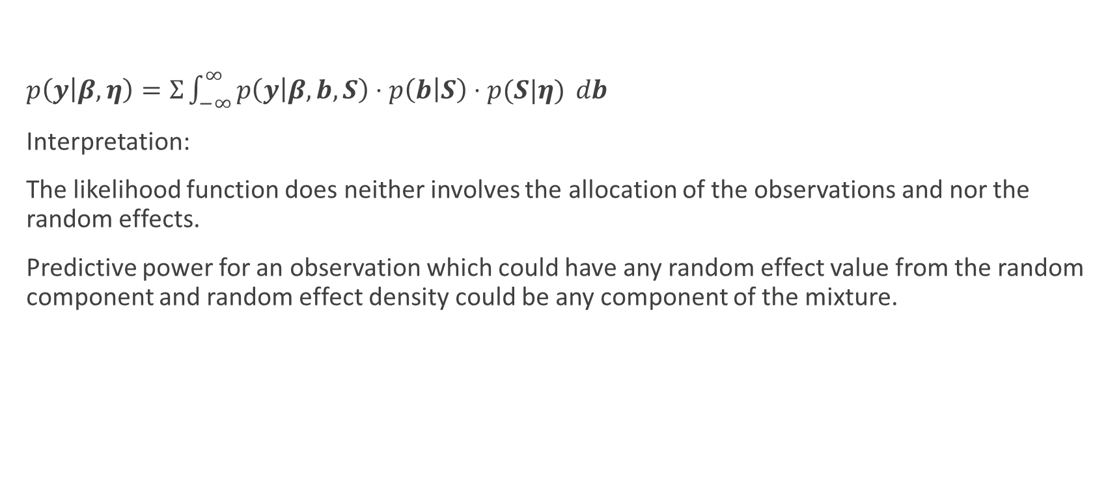
DIC based on observed data likelihood
$p\left(y | β, η\right)=Σ\int_{−∞}^{∞}{p\left(y | β, b, S\right)⋅p\left(b | S\right)⋅p(S|η)} db$
Interpretation:
The likelihood function does neither involves the allocation of the observations and nor the random effects.
Predictive power for an observation which could have any random effect value from the random component and random effect density could be any component of the mixture.

Slide 9
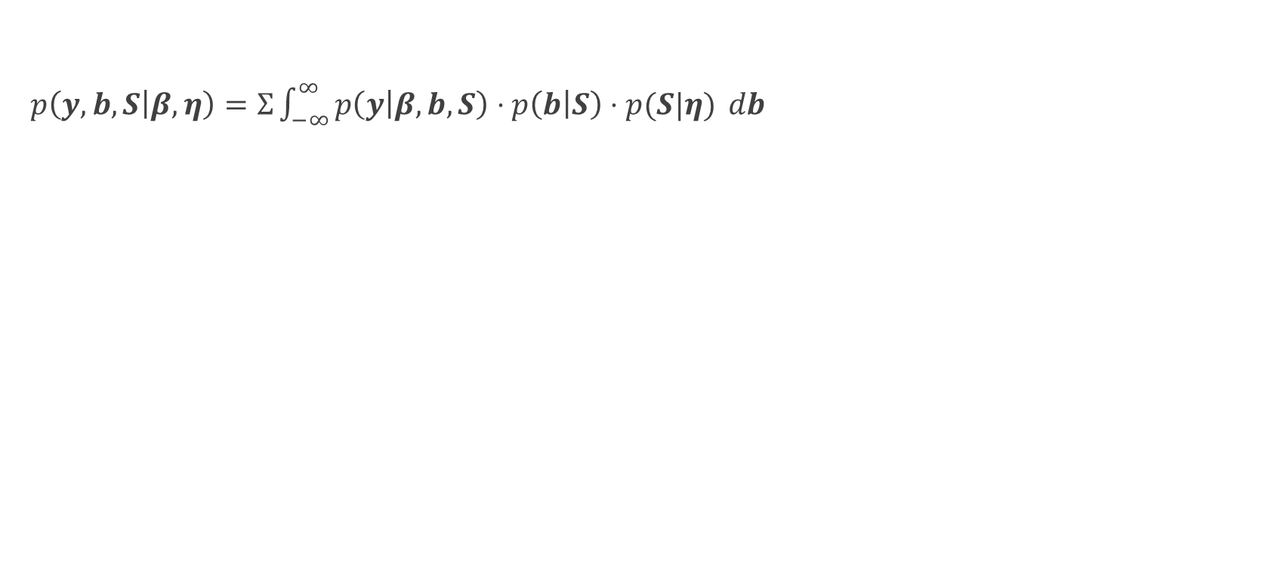
DIC based on complete data likelihood
$p\left(y,b,S | β, η\right)=Σ\int_{−∞}^{∞}{p\left(y | β, b, S\right)⋅p\left(b | S\right)⋅p(S|η)} db$

Slide 10


Issue with the alternative $pD$ formula
$p_{D}=\overline{D(θ)}−D(\overline{θ})$is approximated by $\frac{var\left(D\left(θ\right)\right)}{2}$

Slide 12
What has been done so far?

Slide 13
What remains?

Slide 14
Tools that I am using?
JAGS (just another Gibbs sampler)
R and the various packages

Slide 15

Questions?

